Slide 1

Amadeus
Next gen AI assistant support

Slide 2
Meet the team
Francesco Caracciolo - AI developer
Daniele Cursano – Back-End developer
Flavio Milinanni – Full-Stack developer
Oliver Quin – Front-End developer
Computer engineering students @ Politecnico di Milano

Slide 3

Meet James, the Wealth Manager
Meet James. Every day, he pushes himself to be as sharp as a razor blade. He values clear, fast, and efficient communication, because in his world, time is money. His clients don’t want to wait; they expect answers instantly. ‘I needed this yesterday,’ they say.

Slide 4
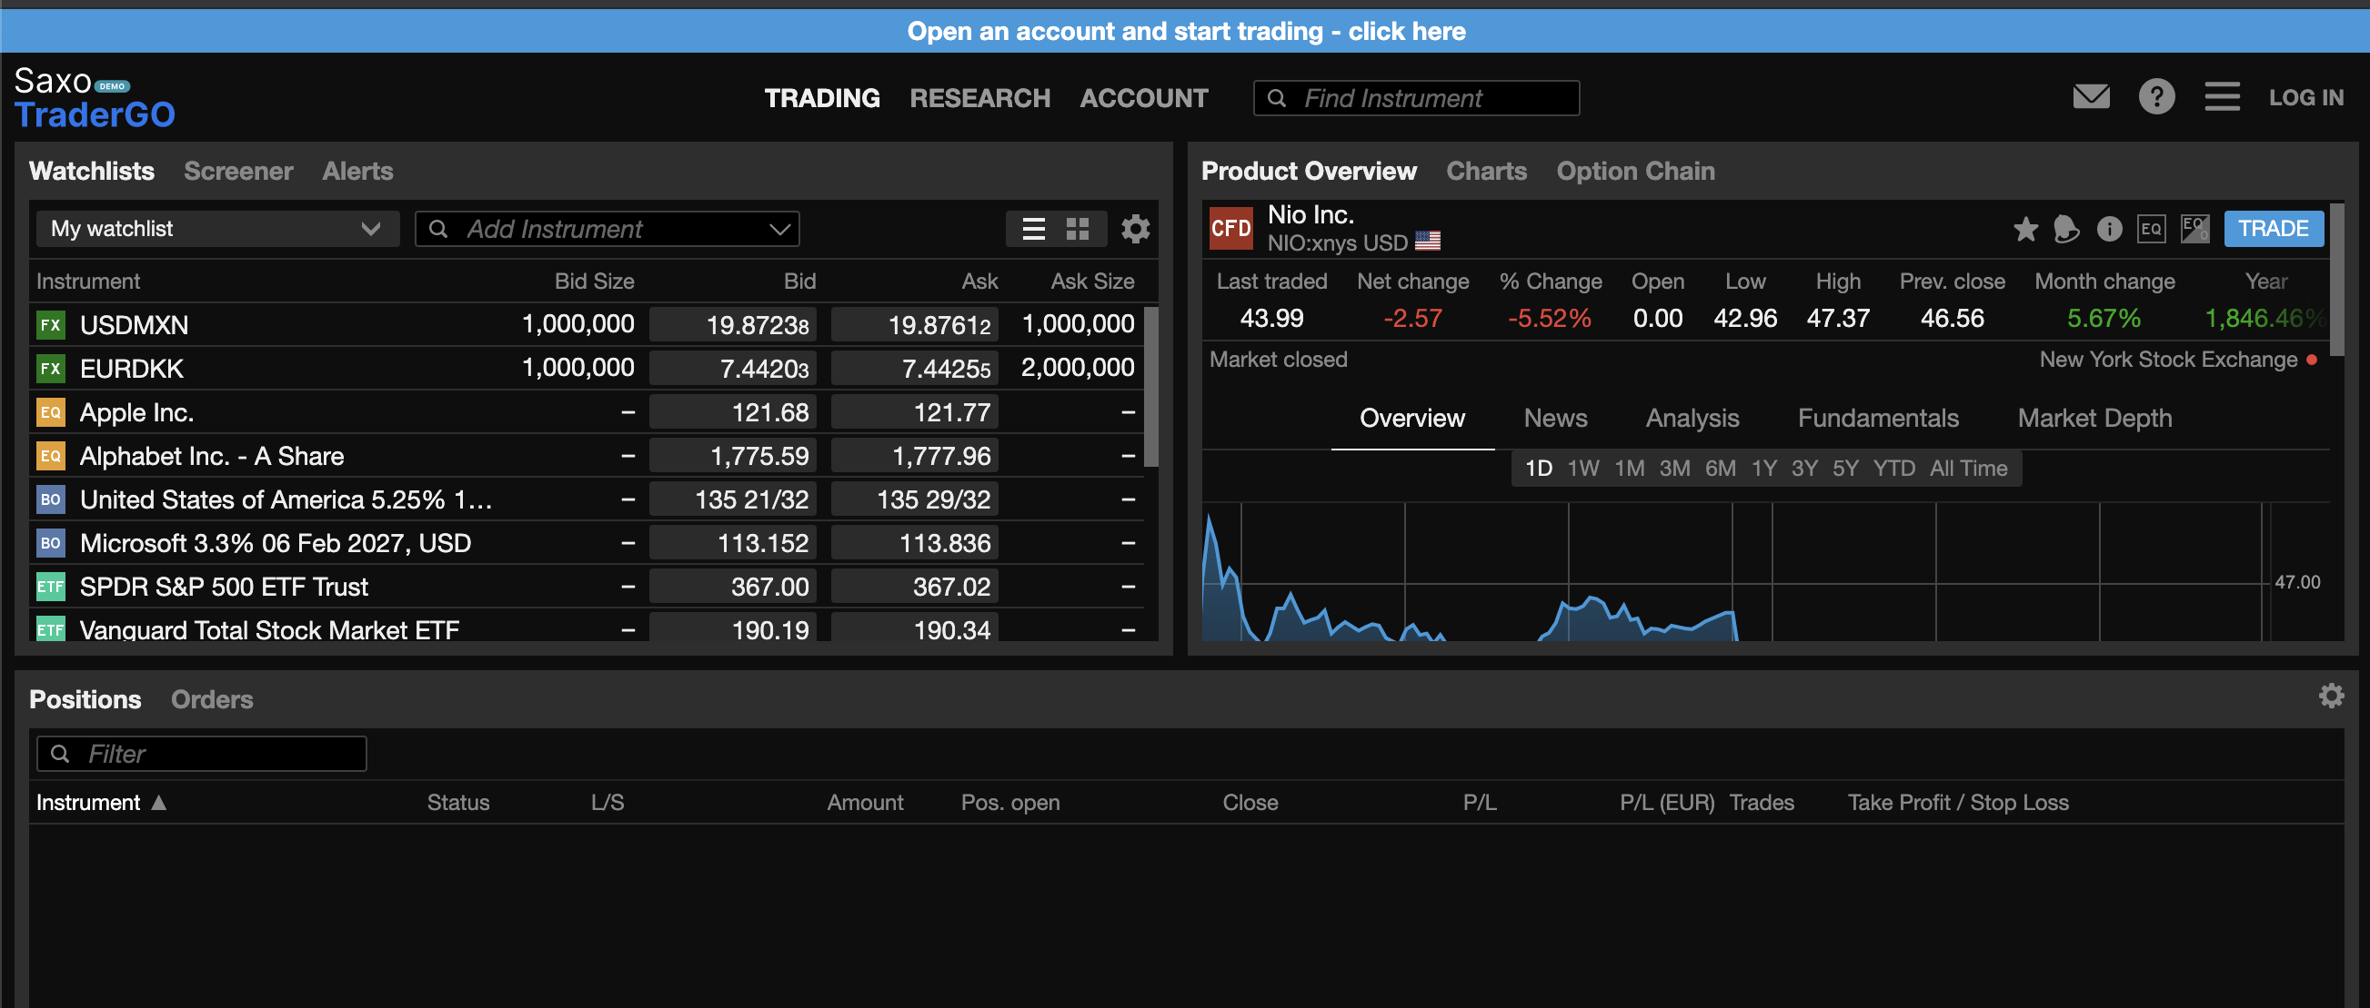
The Reality of Financial Terminale
Now, picture a cutting-edge financial terminal. It’s perfect, except it isn’t. Don’t get James wrong; the terminal does exactly what it was built for: providing an in-depth, technical overview of every single asset and variable that shapes global markets. But James doesn’t need all that

Slide 5

The Information Overload Problem
James isn’t looking for an ISIN code of a thematic ETF tracking the top 10 most influential K-Pop artists. He needs precise, relevant information—right now—about the topic his client is obsessing over. Every second spent searching is a second of lost trust.

Slide 6
Meet Amedeus
About that, let us introduce you to Amadeus, a state-of-the-art AI assistant, designed specifically for wealth managers who work directly with clients. Since the day James met Amadeus, he never looked back.

Slide 7
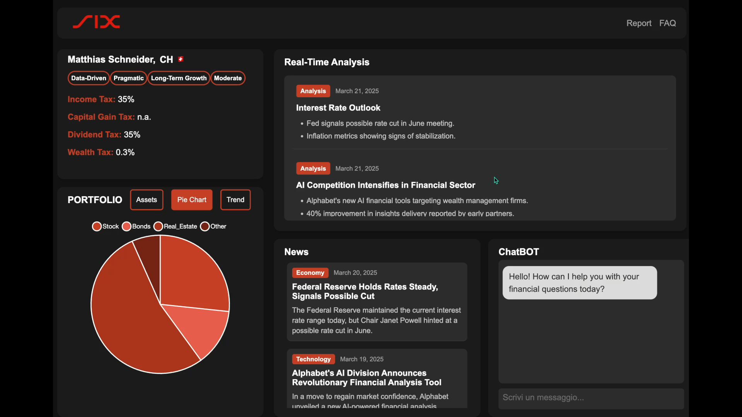
Amadeus
Overview
Amadeus became his most trusted work companion, seamlessly handling the complexities of financial conversations so James can focus on what matters most: his clients.

Slide 8
Amadeus
Understands Clients in Real-Time
powered by Whisper’s voice recognition, Amadeus processes what clients want before they even finish speaking. No more awkward pauses. No more searching for the asset tanking the portfolio

Slide 9
Amadeus
Built-in GPT-Like Chat
When James needs extra analysis, Amadeus offers a secure, private AI chat

Slide 10
Amadeus
Knows Each Client’s Financial Information
Amadeus tracks tax area, taxable income, portfolio composition, and trends, delivering tailored insights without James having to dig for them.

Slide 11
Amadeus
Filters the News, Delivers Hard Facts
Scraping the most reputable financial journals, Amadeus analyzes biases and presents only verified facts, removing unnecessary opinions and noise.

Slide 12
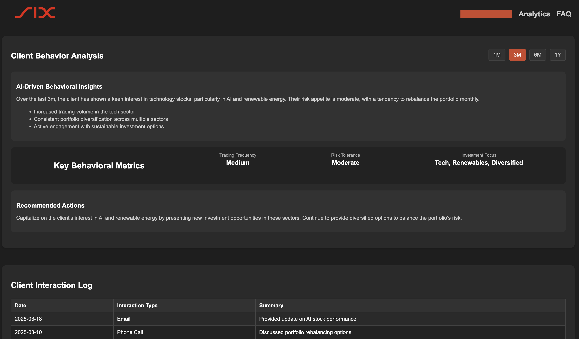
Amadeus
Analyzes client behavior
Analyzing how clients interact with their wealth managers to deliver personalized financial guidance, tracking interactions, preferences, and decision-making patterns.

Slide 13

The days of ‘uhhh… let me check’ are over. With Amadeus, James is always one step ahead, providing seamless, real-time financial insights. No wasted time, no lost trust—just a wealth manager at the top of his game.

Slide 14
Performance Improvements
2.5× More Tokens Per Second – Amadeus processes more data, faster, delivering insights in real-time.
5× Faster Query Processing & Search –
Traditional Office Worker: Typing at 30 words per minute, manually searching.
With Amadeus: 150 words per minute processed via voice recognition.
2/3 the Cost – More power at a lower price:
Industry Standard: $0.60 per token
Amadeus Pricing: $0.40 per token (33% savings)

Slide 15
Business Model
Subscription-Based Model for Affiliated Banks
Subscription Model – Banks affiliated with SIX Financial Information subscribe to Amadeus on a monthly or annual basis.
Scalable Pricing Tiers – Custom pricing based on bank size, number of wealth managers, and AI usage volume.

Slide 16
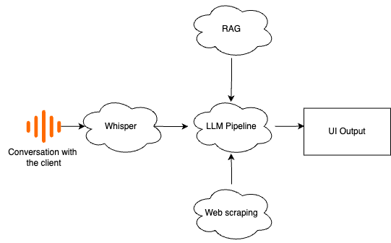
Appendix: Technical schema

